Slide 1
Unit 3 General exam advice
Do not write too much on ‘give’, ‘outline’, ‘identify’ or ‘state’ questions as you WILL run out of time. E.g. a three mark question is achievable in 3 sentences.
Write in context by referring to the name of the business in the question or case study. This goes beyond just mentioning the business’s name. Try to think about the nature of the product the business produces, the market it operates in, or the competitors the business competes against.

Slide 2
Question 1b)
Candidate could have just said “less mistakes”
and got 1 mark.
(or to be more accurate, “fewer mistakes”)

Slide 3
Exam Advice from Chief Examiners
Types of exam questions | What this means you must do
Give State Identify | Require nothing more than a short sentence. Give a brief response. E.g. Identify two elements of the marketing mix which Apple might change to improve its competitiveness. Ans: Profit/Place
Outline one method a business might use to increase its profit. | Command word ‘outline’. Need to identify a method of increasing profit. Then 2 points in relation to the method identified .
Model Answer: A method would be advertising. Profits will go up by boosting sales (1 mark), this will mean more income (1 mark) so there will be more money left over when costs are taken away.

Slide 4
Question 1c) from June 2011
This is an example of an “explain” question that does not require the use of context. This is because the question just refers to a general “business”. In an explain question, you need to highlight a problem and then make two connected statements that explain the problem identified. Explain questions will always be worth 3 marks, and marks will not be awarded for the definition of a key term at the start of the response.

Slide 5
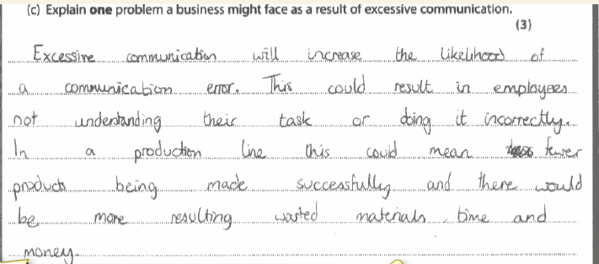
Explain question example
Develops the problem
Identifies a problem
Develops the problem further

Slide 6
Context question
Let’s learn from the advice.
Answer the following question in context

Slide 7
Explain question example
Types of exam questions | What this means you must do
Explain e.g. Explain 1 way in which Just in time method of stock control might benefit a business such as McDonalds | Requires you to develop your answer. All explain questions are based around a context. If reference is made to the context in the question then you must refer to the scenario. Try to use connective words such as ‘this leads to’ or ‘because’….
Model Answer: JIT is important because it means that McDonalds will always have fresh food. (1 mark) This means that people will think that it is higher quality and they will never run out. (1 mark). As a result they will get more customers returning and make more profits (1 mark).

Slide 8
Describe
Types of exam questions | What this means you must do
Describe Describe how the use of the Boston Matrix can benefit a business. | Requires you to make three relevant points associated with what the question is asking.
Model Answer: The Boston Matrix is a planning tool (1 mark). It can help businesses see which products are out of date (1 mark). It can also show a business when they need to invest in new products to replace the dogs (1 mark)

Slide 9
“Choice” questions
Types of exam questions | What this means you must do
Choice questions. When you get to Question 4d you will have a choice question. | You have to make a choice between two options and then explain why you made that decision. No right or wrong answer. To get full marks, you need to answer using the example of the business mentioned in the question and include some kind of balance before arriving at a judgement/conclusion i.e. why it is better than other option.
Model Answer: Conclusion: I think that M&S should increase advertising as this would allow them to make people aware of what they sell and this could lead to an increase in the amount of customers they get. If they advertise and other similar businesses to them like Debenhams do not, then they will be able to attract customers as they remember what M&S sell. As a result this will help the company increase sales and boost profits. There is a problem with this in that it is expensive and could backfire.

Slide 10
In conclusion, I think that increasing advertising is better than reducing prices as M&S is renowned for its quality. Therefore by reducing profits then it could change people thoughts about quality.
Advertising is best but only if it attracts more customers who come and spend money. It could be bad if millions is spent on an and which costs millions and sales go up by less than this. As a result this will mean M&S lose further profits.

Slide 11
A lesson in reading the question accurately
(Question 9)

Slide 12
Last question
The last question is always based around some evidence provided in a small case study at the start of Section C. To reach high scores here, you need to evaluate well and use the rule “it depends…”, but be sure to reach an overall decision.

Slide 13
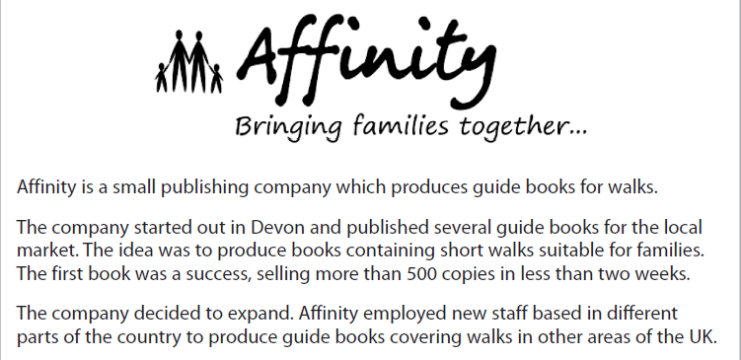
Let’s try a 10 mark question

Slide 14
Using your knowledge of business, assess the importance of good communication to a company such as Affinity.
Introductory paragraph:
Summary of the problems at Affinity and how this could be linked to poor communication
Next paragraph – look at the importance of good communication to business in general and to Affinity
e.g. Reduces the chances of mistakes.
• Improves product quality.
• Increases worker motivation/loyalty.
• Increases business flexibility.
• Increases profit.
• Increases productivity/efficiency.
• Lower unit costs.
Next paragraph – discuss that communication alone will not solve Affinity’s problems. Other factors like product, good cash flow, strong branding customer service, price etc. are key also
Conclude by stating which channel of communication is the most important to addressing the problems at Affinity?

